Slide 1
CSE – 3522 Database Management System Laboratory
INTRODUCTION

Slide 2
What is a Database?
A database is a collection of information that is organized so that it can be easily accessed, managed, and updated
Or
Collection of interrelated data
A set of programs to access the data
A DBMS contains information about a particular enterprise
DBMS provides an environment that is both convenient and efficient to use.

Slide 3
Why do we need Database?
We have some data that needs to be stored, so we need a database.
Use the file system and spreadsheets to store the data.
Having a database just because we have some data is not the main reason. The issue is what comes after we store the data.

Slide 4
Problems of storing Data
Size of data
Ease of updating data
Accuracy
Security
Redundancy
Incomplete data

Slide 5
Database vs File Systems
Much Faster Access- indexing
Concurrent Access- multiple user access at the same time
Transaction Support- Atomic transactions guarantee complete failure or success of an operation.
Scalability- can easily be expanded to fit larger data
Standards Enforcement- enforce specific conditions on data for more authentic data

Slide 6



Used Databases
Produced by oracle Corporation
Relational Database (RDBMS)
Single, integrated back-end
Also produced by Oracle Corporation
open-source
Relational database management system (RDBMS)
Cross-platform
Embedded into the end- program
RDBMS
Popular choice for small apps, even lite websites

Slide 7
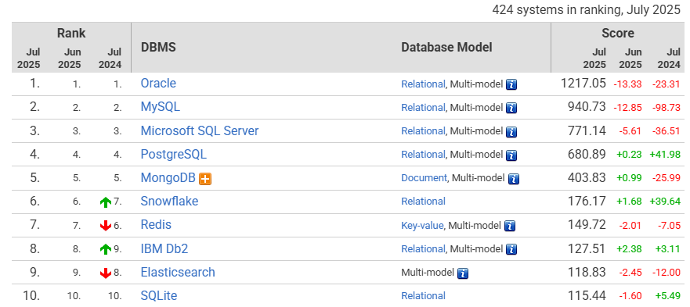
DB Ranking

Slide 8
CSE – 3522 Database Management System Laboratory
SQL
(STRUCTURED QUERY LANGUAGE)

Slide 9
Database
A database is a collection of information, that is organized so that it can be accessed, managed, and updated easily

Slide 10
Database
ID | NAME | DIVISION
201614033 | Afrida Hossain | Dhaka
201614039 | Nipa Howlader | Khulna
201614047 | Shovon Niverd Pereira | Chittagong
201514079 | Shariar Iqbal | Barishal
201614042 | Farhat Lamia Borsha | Dhaka
201614026 | Farhan Sayeed | Dhaka
201614020 | Farahnaz Reza | Barishal
Table 1
DIVISION | DESCRIPTION
Dhaka | Dhaka, set beside the Buriganga River, is the capital of Bangladesh. It’s a hub for trade and culture, with a long history as a seat of government.
Khulna | Khulna is the third-largest city in Bangladesh. It is the administrative seat of Khulna District and Khulna Division
Chittagong | Chittagong is a major coastal seaport city and financial centre in southeastern Bangladesh.
Barisal | Barisal is a major city that lies on the bank of Kirtankhola river in south-central Bangladesh.
Table 2

Slide 11
Steps
Create table
Specify columns
Specify column datatypes
Insert data
Display data
Modify data
Delete data

Slide 12
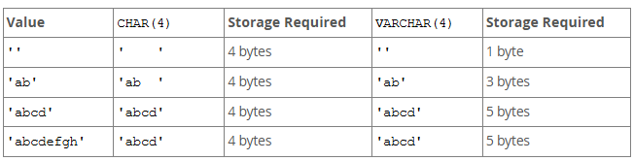
Character Datatypes
Datatype | Description
VARCHAR(size) | Variable-length character string having maximum length size.
CHAR(size) | Fixed-length character data of length size bytes or characters.

Slide 13
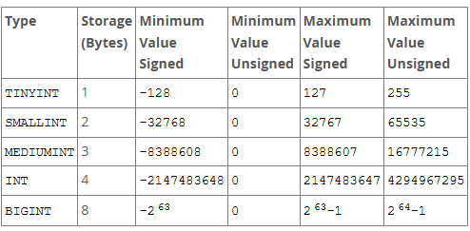
Numeric Datatypes
MySQL supports the SQL standard integer types INTEGER (or INT) and SMALLINT. As an extension to the standard, MySQL also supports the integer types TINYINT, MEDIUMINT, and BIGINT. The following table shows the required storage and range for each integer type.

Slide 14
Numeric Datatypes
Datatype | Description
DECIMAL(precision, scale) or NUMERIC(precision, scale) | Precision is the total number of digits and Scale is the number of digits to the right (positive) or left (negative) of the decimal point. For example, DECIMAL(7,2) is a number that has 5 digits before the decimal and 2 digits after the decimal.
Float, Decimal, Double
Example:
Precision 4, scale 2: 99.99
Precision 10, scale 0: 9999999999
Precision 8, scale 3: 99999.999
Precision 5, scale -3: 99999000

Slide 15
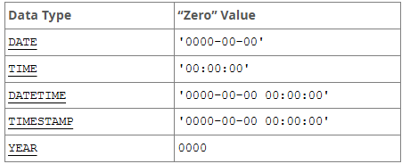
Date/Time Datatypes
Datatype | Description
DATE, TIME, DATETIME, TIMESTAMP, YEAR | Used to store point-in-time values (dates and times) in a table.
Follow the link for more data types of the MySQL database.

Slide 16
Table Design
Before creating a table, the user should examine what type of data it will contain
The actual data values to be stored in the table to determine the data type and width to be assigned to each column

Slide 17
When You Create a Table (1/3)
The table must be assigned a unique name
The name of a table can be no longer than 64 characters
At least one column must be defined
The columns within each table must be unique
Each column within the table must be assigned a column name and a data type.
The name of a column can be no longer than 64 characters

Slide 18
When You Create a Table (2/3)
The underscore symbol ( _ ) is allowed in table and column names
Data type specifies what type of data will be stored in that column
The width of the column can also be stated
A table can be created based on data retrieved through a subquery

Slide 19
When You Create a Table (3/3)
Once a table has been created, the structure of the table can be changed using the ALTER TABLE command with the appropriate clause
To change the name of an existing table, the RENAME command is used

Slide 20
Design a Table: Customer (1/5)
Cust_id
Column 1
Purpose: To uniquely identify each Customer
Field name: Cust_id
Datatype: VARCHAR (because the column will consist of both letters and numbers)
Width: 12

Slide 21
Design a Table: Customer (1/5)
Cust_id
Column 1
Purpose: To uniquely identify each Customer
Field name: Cust_id
Datatype: VARCHAR (because the column will consist of both letters and numbers)
Width: 12

Slide 22
Design a Table: Customer (2/5)
Cust_id | Cust_name
Column 2
Purpose: To store the first and last name of each Customer
Field name: Cust_name
Contents: text data
Datatype: VARCHAR
Width: 20 (20 characters probably enough; can easily increase size if necessary)

Slide 23
Design a Table: Customer (2/5)
Cust_id | Cust_name
Column 2
Purpose: To store the first and last name of each Customer
Field name: Cust_name
Contents: text data
Datatype: VARCHAR
Width: 20 (20 characters probably enough; can easily increase size if necessary)

Slide 24
Design a Table: Customer (3/5)
Cust_id | Cust_name | Cust_dob
Column 3
Purpose: To store the date of birth of each Customer
Field name: Cust_dob
Contents: Date of Birth
Datatype: DATE
Width: (automatically handled by MySQL)

Slide 25
Design a Table: Customer (3/5)
Cust_id | Cust_name | Cust_dob
Column 3
Purpose: To store the date of birth of each Customer
Field name: Cust_dob
Contents: Date of Birth
Datatype: DATE
Width: (automatically handled by MySQL)

Slide 26
Design a Table: Customer (4/5)
Cust_id | Cust_name | Cust_dob | Cust_street
Column 4
Purpose: To store the street address of each Customer
Field name: Cust_street
Contents: Street Address
Datatype: VARCHAR
Width: 12

Slide 27
Design a Table: Customer (4/5)
Cust_id | Cust_name | Cust_dob | Cust_street
Column 4
Purpose: To store the street address of each Customer
Field name: Cust_street
Contents: Street Address
Datatype: VARCHAR
Width: 12

Slide 28
Design a Table: Customer (5/5)
Cust_id | Cust_name | Cust_dob | Cust_street | Cust_city
Column 5
Purpose: To store the CITY of each Customer
Field name: Cust_city
Contents: City of Customers
Datatype: VARCHAR
Width: 12

Slide 29
Design a Table: Customer (5/5)
Cust_id | Cust_name | Cust_dob | Cust_street | Cust_city
Column 5
Purpose: To store the CITY of each Customer
Field name: Cust_city
Contents: City of Customers
Datatype: VARCHAR
Width: 12

Slide 30
Create Table
Basic syntax:
CREATE TABLE table_name
(column_name1 datatype [DEFAULT value],
column_name2 datatype [DEFAULT value],
column_name3 datatype [DEFAULT value], …);

Slide 31
Create a Table Customer
Create table Customer
(
Cust_id VARCHAR(12) NOT NULL,
Cust_name VARCHAR(20),
Cust_dob DATE,
Cust_street VARCHAR(12),
Cust_city VARCHAR(12) DEFAULT 'DHAKA'
);

Slide 32
Insert Data
Form of INSERT Command
Single-Row Insert
Multi Row Insert

Slide 33
Single Row INSERT Command (1/4)
Basic Syntax:
INSERT INTO table_name (column1,column2,column3,...) VALUES (value1,value2,value3,...);

Slide 34
Try
Basic Syntax:
INSERT INTO table_name (column1,column2,column3,...) VALUES (value1,value2,value3,...);
Table Name: Customer
Cust_id | Cust_name | Cust_dob | Cust_street | Cust_city
C00000000001 | C_A | 11-JAN-1982 | c_street_006 | c_city_001

Slide 35
Single Row INSERT Command (2/4)
INSERT INTO CUSTOMER
(Cust_id, Cust_name, Cust_dob, Cust_street, Cust_city) VALUES
(‘C000000001', 'C_A’, ‘2020-01-15’, 'c_street_006', 'c_city_001');
After executing this, one will see the message:
"1 row created"
Notes:
to_date('23-Dec-1952','DD-MON-YYYY')

Slide 36
Single Row INSERT Command (3/4)
INSERT INTO CUSTOMER
(Cust_id, Cust_name, Cust_city) VALUES
('C00000000002', 'C_B', 'c_city_002');
After executing this, one will see the message:
"1 row created"

Slide 37
Single Row INSERT Command (3/3)
Any missing values will be NULL, unless a DEFAULT value is provided in the table definition
Column list is optional

Slide 38
Multi-Row INSERT Command
Basic Syntax
Uses a sub query allowing zero, one or more rows to insert
Example:
Create a new table named NEW_CUSTOMER using similar columns of table CUSTOMER

Slide 39
Multi-Row INSERT Command
INSERT INTO NEW_CUSTOMER
SELECT * FROM CUSTOMER;

Slide 40
Multi-Row INSERT Command
INSERT INTO NEW_CUSTOMER
SELECT * FROM CUSTOMER;
Now Write,
SELECT * FROM NEW_CUSTOMER
Cust_id | Cust_name | Cust_dob | Cust_street | Cust_city
C00000000001 | C_A | 11-JAN-1982 | c_street_006 | c_city_001
C00000000002 | C_B |  |  | c_city_002

Slide 41
Problems!
How can we show the inserted data from the database?

Slide 42
Problems!
How can we show the inserted data from the database?
SELECT Command!!!

Slide 43
SELECT Statement
SELECT statements are used to retrieve data from the database

Slide 44
SELECT Statement
Basic Syntax:
Every SELECT statement is required to have a SELECT and FROM clause. A clause always begins with a keyword.
The SELECT clause is used to identify the column or columns to be retrieved from a table
The name of the table is identified in the FROM clause.

Slide 45
SELECT Statement
Select all of the data (i.e., all rows and columns) in a table
SELECT * FROM CUSTOMER;
Select cust_name column from the Customer table
Select cust_id, cust_name, cust_city columns from the Customer table

Slide 46
DO it !
1. Create an EMPLOYEE table which consists
- Emp_id, datatype VARCHAR2, size 20
- Emp_name, datatype VARCHAR2, size 20
- Emp_dob, datatype DATE
- Emp_salary, datatype NUMBER
- Emp_city, datatype VARCHAR2, size 20

Slide 47
DO it !
Employee
Emp_id | Emp_name | Emp_dob | Emp_salary | Emp_city
E_001 | E_A | 11-JAN-1982 | 20000 | Dhaka
E_002 | E_B | 21-JUN-1985 | 30000 | -
E_003 | E_C | 18-MAR-1995 | 40000 | Sylhet

Slide 48
Problems!
What'll be done if any one inserts wrong data by mistake?
How can we insert the missing data of row2?

Slide 49
Problems!
What'll be done if any one inserts wrong data by mistake?
How can we insert the missing data of row2?
UPDATE Command!!!

Slide 50
UPDATE
Use UPDATE command to -
Change existing values
Add values to an existing row
Basic Syntax:
UPDATE tablename
SET columnname = newvalue
[WHERE condition];

Slide 51
UPDATE
UPDATE clause identifies the table
SET clause identifies the column(s) being changed and new value(s)
Optional WHERE clause specifies row(s) to be changed;
if omitted, it will update all rows
Basic Syntax:
UPDATE tablename
SET columnname = newvalue
[WHERE condition];

Slide 52
UPDATE
Emp_id | Emp_name | Emp_dob | Cust_salary | Cust_city
E_001 | E_A | 11-JAN-1982 | 20000 | Dhaka
E_002 | E_B | 21-JUN-1985 | 30000 | -
E_003 | E_C | 18-MAR-1995 | 40000 | Sylhet
UPDATE tablename
SET columnname = newvalue
[WHERE condition];

Slide 53
UPDATE
Emp_id | Emp_name | Emp_dob | Emp_salary | Emp_city
E_001 | E_A | 11-JAN-1982 | 20000 | Dhaka
E_002 | E_B | 21-JUN-1985 | 50000 | -
E_003 | E_C | 18-MAR-1995 | 40000 | Sylhet
Example:
UPDATE Employee SET Emp_salary=50000 Where Emp_id=‘E_002’ ;

Slide 54
Adding Values to an Existing Row
Emp_id | Emp_name | Emp_dob | Emp_salary | Emp_city
E_001 | E_A | 11-JAN-1982 | 20000 | Dhaka
E_002 | E_B | 21-JUN-1985 | 50000 | -
E_003 | E_C | 18-MAR-1995 | 40000 | Sylhet
Add ‘Dhaka’ as employee city to the employee who has an employee id E_002

Slide 55
UPDATE
Emp_id | Emp_name | Emp_dob | Emp_salary | Emp_city
E_001 | E_A | 11-JAN-1982 | 20000 | Dhaka
E_002 | E_B | 21-JUN-1985 | 50000 | Dhaka
E_003 | E_C | 18-MAR-1995 | 40000 | Sylhet
Example:
UPDATE Employee SET Emp_city = ‘Dhaka’ Where Emp_id =‘E_002’;

Slide 56
Operations within SELECT Statement
Column alias can be used for column headings
Suppress duplicates
Concatenate data

Slide 57
Column Alias (1/3)
Emp_id | Emp_name | Emp_dob | Emp_salary | Emp_city
E_001 | E_A | 11-JAN-1982 | 20000 | Dhaka
E_002 | E_B | 21-JUN-1985 | 50000 | Dhaka
E_003 | E_C | 18-MAR-1995 | 40000 | Sylhet
After Aliasing ( After customizing column name)
Employee ID | Employee Name | Date 0f Birth | Employee Salary | Employee City
E_001 | E_A | 11-JAN-1982 | 20000 | Dhaka
E_002 | E_B | 21-JUN-1985 | 50000 | Dhaka
E_003 | E_C | 18-MAR-1995 | 40000 | Sylhet

Slide 58
Column Alias (2/3)
Basic Syntax:
SELECT column_name "The name you want to display" FROM table_name
OR
SELECT column_name AS "The name you want to display" FROM table_name

Slide 59
Column Alias (3/3)
Emp_id
E_001
E_002
E_003
Employee ID
E_001
E_002
E_003
SELECT Emp_id “Employee ID" FROM Employee
OR
SELECT Emp_id AS " Employee ID " FROM Employee
SELECT column_name “The name you want to display " FROM table_name
OR
SELECT column_name AS " The name you want to display " FROM table_name

Slide 60
Suppress duplicates
Name the cities where employees live.
Emp_city
Dhaka
Dhaka
Sylhet
There are unnecessary duplicate values!!!!

Slide 61
Suppressing Duplicates
To suppress duplicate values, enter DISTINCT after the SELECT keyword
SELECT DISTINCT Emp_city FROM Employee;
Emp_city
Dhaka
Dhaka
Sylhet
Emp_city
Dhaka
Sylhet

Slide 62
Concatenate data
E_A has an Employee ID E_001.
Extra String !!!

Slide 63
Concatenation
Can combine data with a string literal
Use the concatenation operator ||
Allows use of column aliasing

Slide 64
Concatenation
Basic Syntax
SELECT CONCAT(Column_Name, “Hello world”, Column_Name FROM table_name;

Slide 65
Concatenation
E_A has an Employee ID E_001
SELECT CONCAT(Column_Name, ' The string you want to concate ' ,Column_Name) FROM table_name;

Slide 66
Concatenation
E_A has an Employee ID E_001
SELECT Emp_name || ' has an Employee ID ' || Emp_id FROM Employee WHERE Emp_id = ‘E_001’ ;

Slide 67
Date Format
To show any DATE in a specific format –
SELECT to_char(Emp_dob, 'mm/dd/yyyy') FROM Employee;
Emp_dob
11-JAN-1982
21-JUN-1985
18-MAR-1995
Emp_dob
11/JAN/1982
21/JUN/1985
18/MAR/1995

Slide 68
TO_DATE() Function
TO_DATE converts char of CHAR, VARCHAR2, NCHAR, or NVARCHAR2 data type to a value of DATE data type
Syntax:
SELECT TO_DATE('1999-JAN-05', 'YYYY-MON-DD') FROM Customer;

Slide 69
DELETE (1/3)
DELETE command removes entire rows from a table
Cannot be applied for specific column
If no WHERE clause is specified, all rows will be deleted

Slide 70
DELETE (2/3)
Basic Syntax
DELETE FROM tablename
[WHERE condition];
Example:
DELETE FROM Employee;
DELETE FROM Employee WHERE Emp_id = ‘E_001’

Slide 71
DELETE (3/3)
To delete the whole table
DROP TABLE table_name;
Example:
DROP TABLE Employee;

Slide 72
Practice 1
Create and Insert the following data into the EMPLOYEE table
E_id | E_name | E_dob | E_street | E_city | E_startdate
E01 | Nayeem | 11-JAN-1996 | e_s_001 | Dhaka | 1-JAN-2012
E02 | Sayed | 06-FEB-1996 | e_s_002 | Khulna | 1-JAN-2013
E03 | Ashraf | 08-MAR-1996 | e_s_003 | Dhaka | 1-JAN-2014
E04 | Ashik | 1-JUN-1996 | e_s_004 | Dhaka | 1-JAN-2012
E05 | Shovon | 1-JAN-1996 | e_s_005 | Barisal | 1-JAN-2013
E06 | Iffat | 1-DEC-1996 | e_s_006 | Khulna | 1-JAN-2015

Slide 73
Practice 1
1. Display all of the records in the EMPLOYEE table
2. Display the employee id and employee city names for all records in the EMPLOYEE Table
3. Display the name, living street, and date of birth of the employees for all records in the EMPLOYEE table.

Slide 74
Practice 1
4. Display the Employee_name and Employee_id for all of the records in the Employee table. There should be a column alias “Name of the Employee”, “ID of the Employee” for both the column.
5. Display a list of unique Employee_city records within the Employee table
6. Display the concatenation of the Employee_name, “lives in” and Employee_city for all of the records in the Employee table.

Slide 75
References
Oracle Built-in Datatypes
Stackoverflow
Book: Database System Concepts written by Avi Silberschatz, Henry F. Korth, S. Sudarshan

Slide 76


